Slide 1


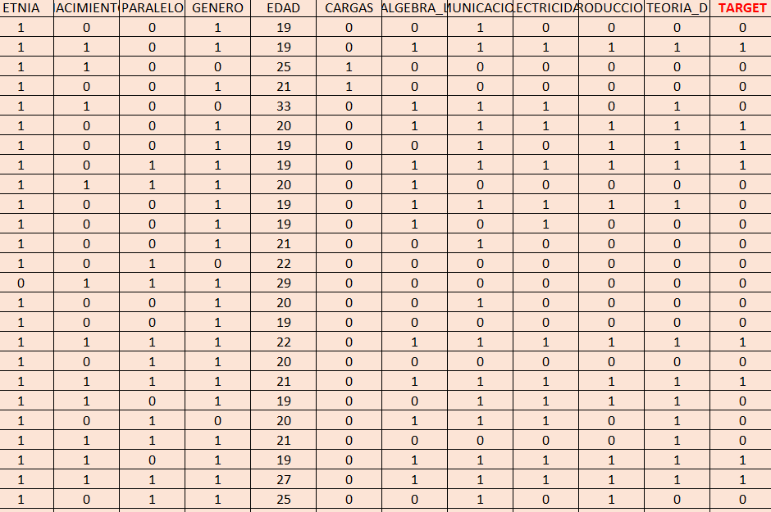
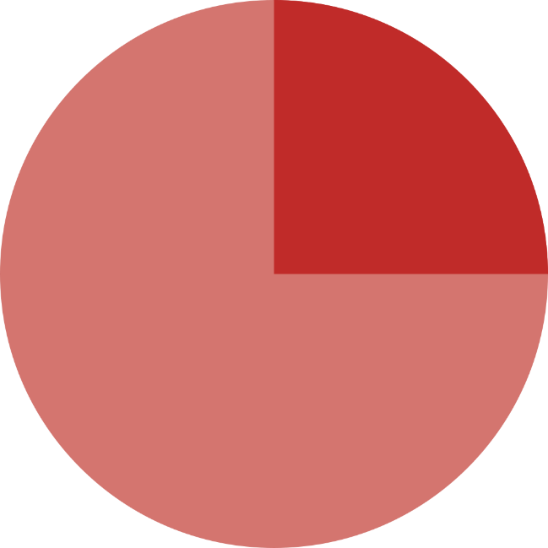
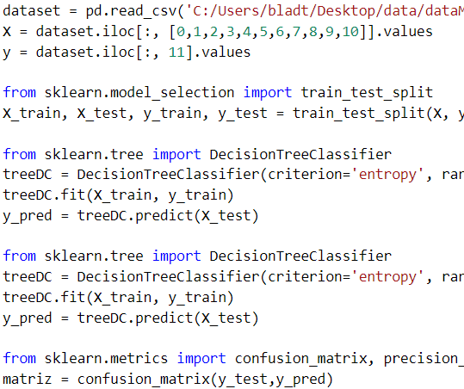
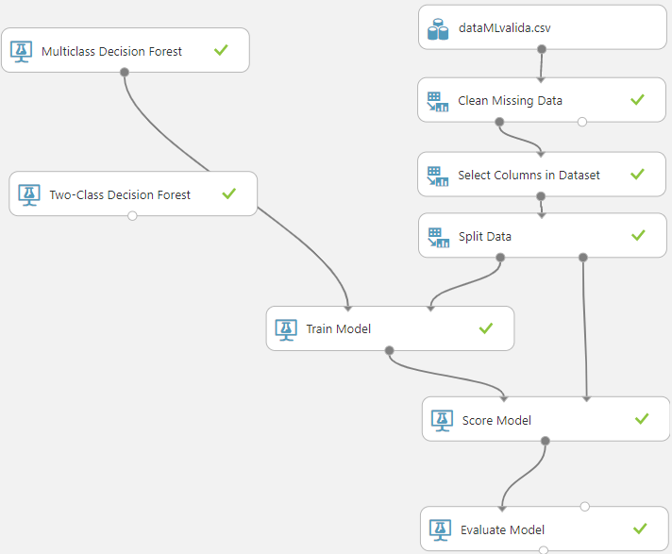
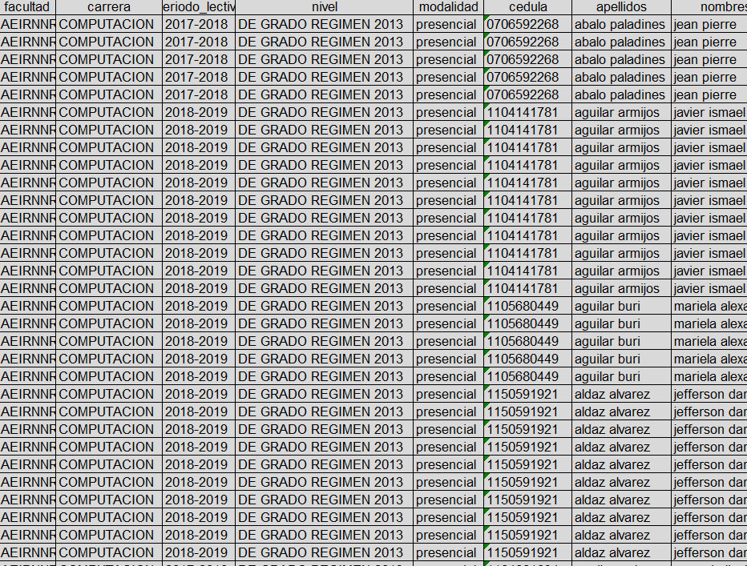


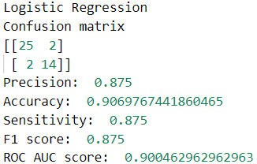
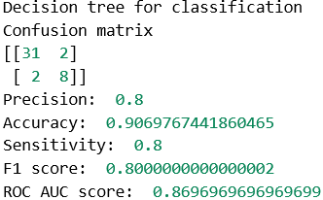
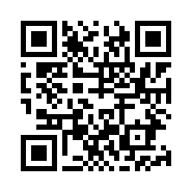
Supervised machine learning for knowledge discovery using the database of “Computing students”
Facultad de Energía, Carrera de Ingeniería en Sistemas
Bladimir S. Minga-Medina
Abstract
In the present work we used supervised automatic learning algorithms and a set of data belonging to students of the “Carrera de Computación” of the Universidad Nacional de Loja (UNL), with the aim of predicting whether a student passes or fails the second academic cycle. In the data pre-processing phase, 12 of the 51 features that initially made up the data were selected and the textual values were replaced by nominal (binary) values, in order to represent the classes. Subsequently, the data was divided for training and testing, using the "hold out" method, into 75% and 25% respectively. The models used were: Logistic Regression and Decision Trees for Classification, in the Python language. Finally, to validate the model the following metrics were considered: Confusion matrix, precision, accuracy, sensitivity, F1 score and ROC AUC score.
1. Problem
3. Data preparation
Computer Science and CIS have a high repetition and dropout rate.
Request addressed to the director of the UTI - UNL
Education
Economy
Technology
Supervised learning
(Binary classification)
4. Data splitting
Method “hold out”
25 %
Test
75 %
Training
DATA
5. Training a model
2. Data collection
6. Model validation
https://github.com/bsmm1995/IA---resources
Artificial Intelligence (2019-2020)
“Noveno ciclo”
bsmingam@unl.edu.ec

